Slide 1
Customer Churn Analysis
Capstone Project
PRESENTED BY:
MADHU PRIYA S,
EMP20251210-069,
Data Science Intern,
The Developers Arena.

Slide 2
Business Problem
Customer churn impacts revenue & growth
Need to identify churn drivers
Retention is cheaper than acquisition

Slide 3
Project Objectives
Analyze customer churn using real business data
Understand churn patterns and key drivers
Apply data cleaning, EDA, and statistical analysis
Provide actionable business recommendations

Slide 4
Dataset Overview
Customer churn dataset with 500 records
Customer demographics and billing information
Tenure
Target variable
Yes
No
Key fields
Monthly Charges
Contract
Payment Method
Churn

Slide 5
Data Cleaning Process
Standardized column names
Converted incorrect data types
Handled missing values
Removed duplicate records
Prepared clean dataset for analysis

Slide 6
Exploratory Data Analysis
Analyzed churn distribution
Visualized insights using plots
Studied tenure impact on churn
Compared monthly charges across churn groups

Slide 7
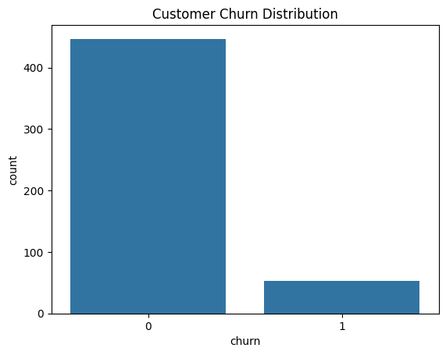
Churn Distribution

Slide 8
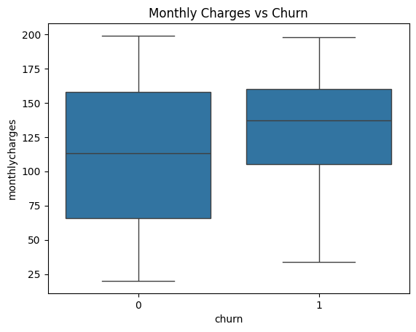
Monthly Charges vs Churn

Slide 9
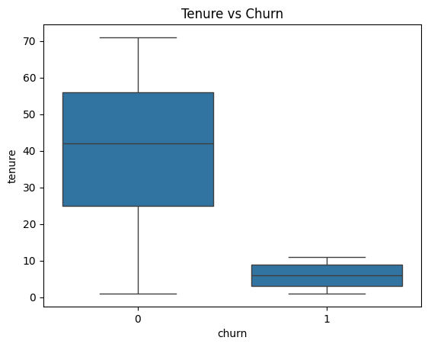
Tenure vs Churn

Slide 10
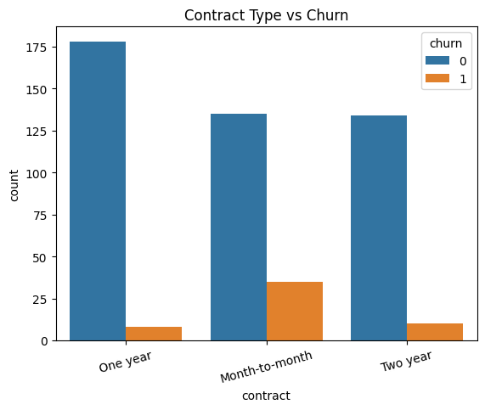
CONTRACT TYPE VS CHURN

Slide 11
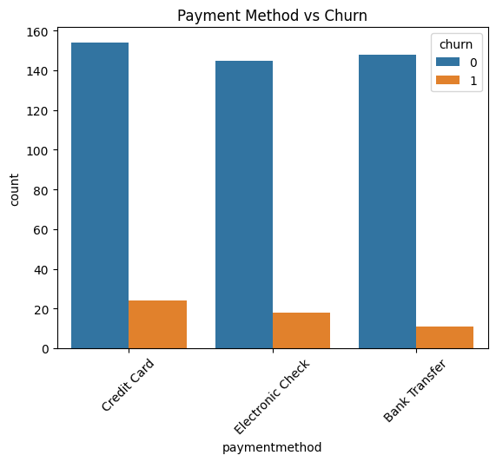
PAYMENT METHOD VS CHURN

Slide 12
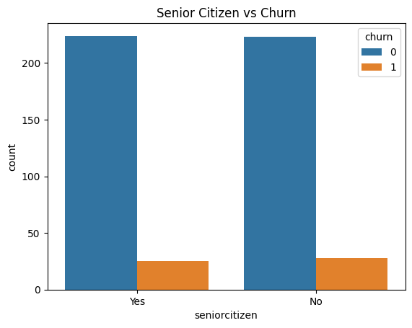
SENIOR CITIZEN VS CHURN

Slide 13
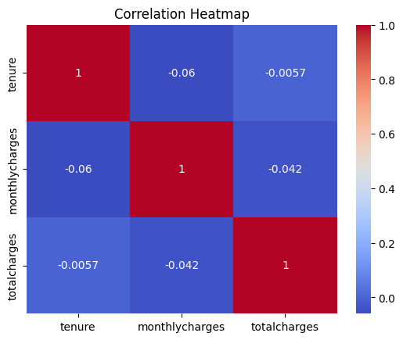
CORRELATION HEATMAP

Slide 14
Key EDA Insights
Higher monthly charges increase churn
New customers have higher churn risk
Month-to-month contracts show highest churn
Long-term customers are more loyal
Long-term contracts reduce churn

Slide 15
Statistical Analysis
t-tests used for numerical variables
Chi-square tests for categorical relationships
Statistical significance validated
p-values < 0.05 for key factors

Slide 16
Key Findings
Pricing significantly impacts churn
Customer tenure is a strong retention factor
Contract structure influences churn
Results supported by statistics

Slide 17
Business Recommendations
Promote long-term contracts
Improve onboarding experience
Optimize pricing strategy
Target high risk customers

Slide 18
Conclusion
Churn is measurable and manageable
Analysis supports business growth
Data-driven strategies reduce churn
Data-driven strategies improve retention

